Slide 1
PREDICTING AUSTIN BCYCLE STATION INACTIVITY

Slide 2
Q:
What features are most predictive of an Austin BCycle station going “inactive”
** inactive stations are defined as having no available bikes to start a ride, or equivalently, no available docks to end a ride.

Slide 3
Project Outline
Data Cleaning
Data Wrangling
Inactivity Visualizations
Day
Day + hour
Station
Weather
Weather + station
Station size
Location
Predictive Models
Hyperparameter tuning
Analysis
Conclusions + Future Directions

Slide 4
Meet the data!
BIKE TABLE
Size: 25.7 MB
Shape: (843,126, 4)
Columns:
Station_id
Datetime
Bikes
Docks
STATION TABLE
Size: 2.4 KB
Shape: (50, 6)
Columns:
Station_id
Name
Address
Latitude
longitude
WEATHER TABLE
Size: 11.0 KB
Shape: (61, 23)
Columns:
Date
. . .
(22 other weather stats)
All data was originally sampled from the Austin Bcycle website every 5 minutes over the course of April and May 2016. The data was split into three files, and thus produced three tables.

Slide 5
Data Cleaning & Wrangling
Null values, type conversion, feature extraction

Slide 6
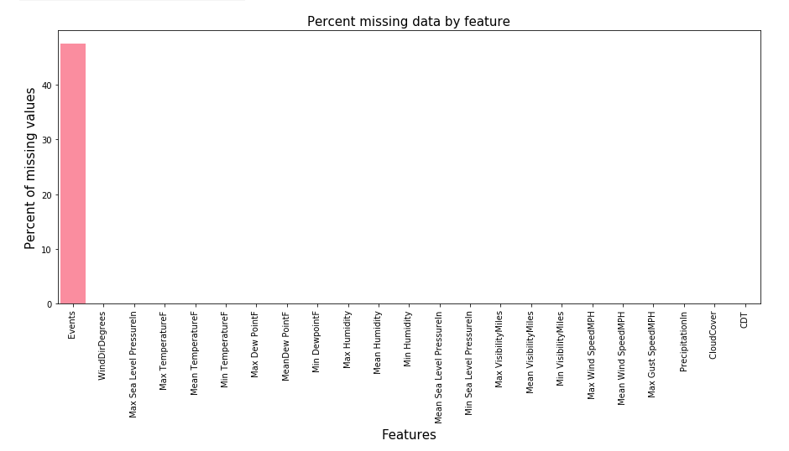
Since only one feature, events, contained missing values, I was able to fill them externally using the original datasource (weatherunderground).

Slide 7
Datetime features were converted to pandas datetime objects for proper analysis.

Slide 8
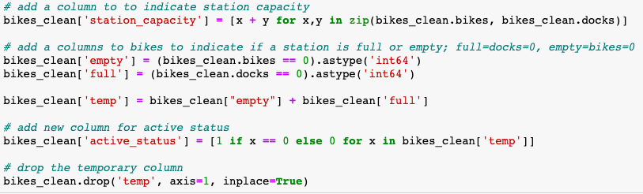
Feature extraction:
‘station_capacity’ added to represent the total number of docks at that station
‘empty’ and ‘full’ added to indicate if a station is currently full (no open docks) or empty (no available bikes)
‘active_status’ is the target variable, which indicates if a station is inactive in any given 5 minute period

Slide 9
Exploratory Data Analysis

Slide 10
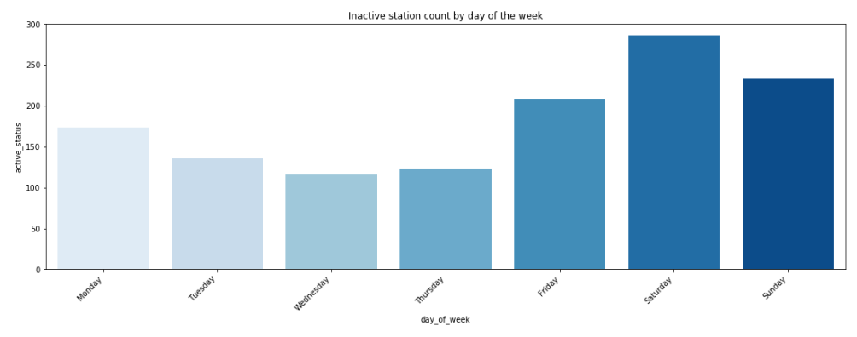
This graph shows that stations are inactive most often on weekends, especially Saturdays.

Slide 11
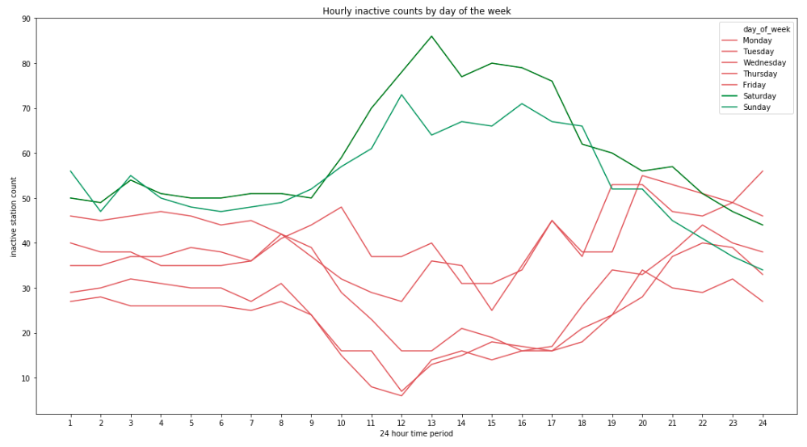

Slide 12
After separating by hour, we can see that during weekends (highlighted in green), stations are most likely to be inactive from around 9am to 7pm. This is likely attributable to bikers taking leisure rides during the daytime on weekends, which is common around Town Lake in Austin.
Weekdays (highlighted in red), show an opposite pattern: station inactivity levels are higher in the morning and evening than during the daytime. This is probably due to users taking trips to commute to work.

Slide 13
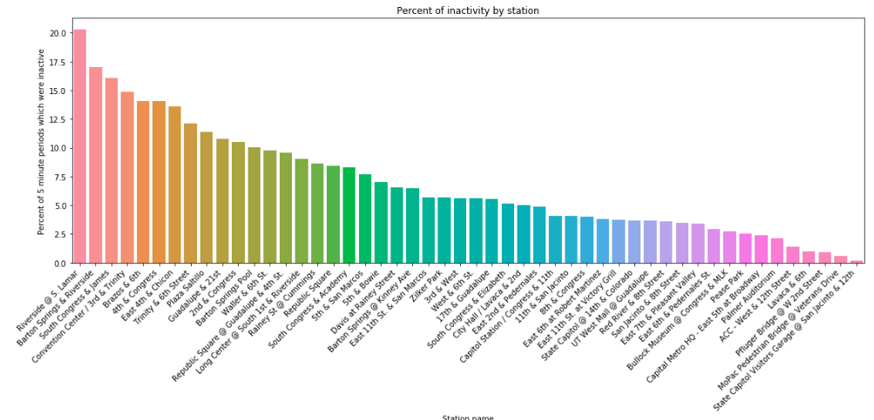
Looking now at data variation by station, we can see the stations that tend to become inactive more often than others. In our case, the stations that became inactive the most are centered around downtown areas, tourist attractions, and parks.

Slide 14
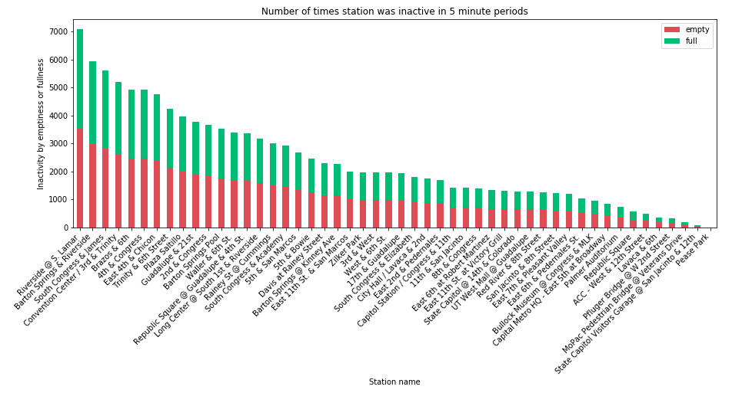
The reason for inactivity (empty or full) is not heavily influenced by the location.

Slide 15
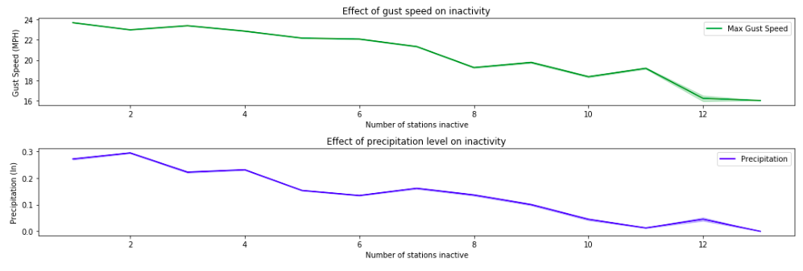
Expectedly for biking, as the wind speed decreases, the number of stations inactive increases.
Also non surprisingly, when it rained less inches in Austin, the number of stations inactive increases. This is probably due to the fact that riders typically ride more on sunny days then on rainy days.

Slide 16
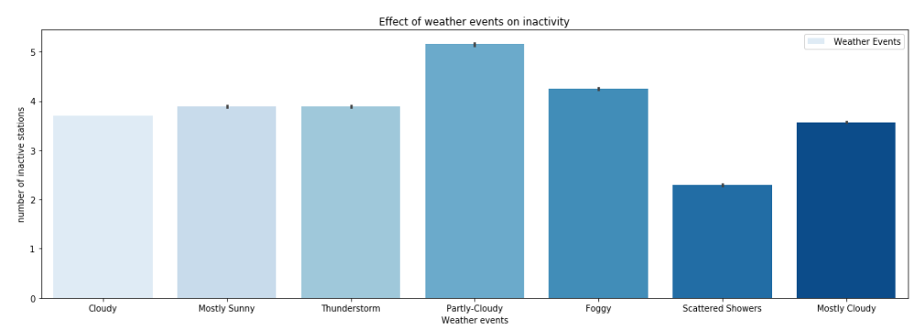
As expected from the precipitation graph, the least amount of stations are inactive during scattered showers days.
Though I predicted the mostly sunny days would show highest levels of inactivity, it is actually partly-cloudy. I believe this is probably due to the fact that more time periods during the recorded months were partly-cloudy days than were sunny.

Slide 17
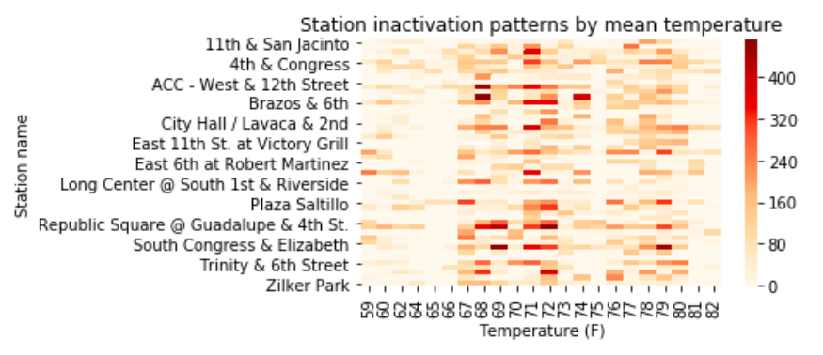
Stations go inactive most frequently when temperatures are at a moderate level, about 67 - 80 degrees. This makes sense, as biking is most enjoyable when it is comfortable outside. This correlation is strongest around 71 degrees

Slide 18
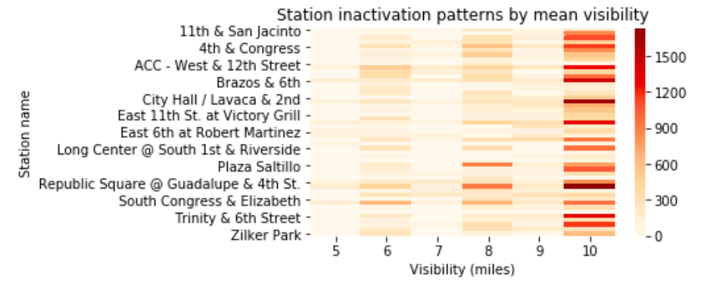
A clear pattern is seen in which stations are inactive more often during high visibility time periods. This observation aligns with my predictions, since low visibility generally makes biking more difficult, stressful, and cumbersome.

Slide 19
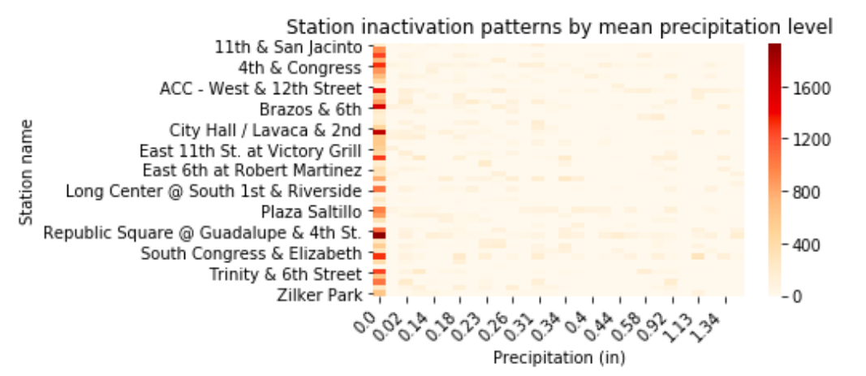
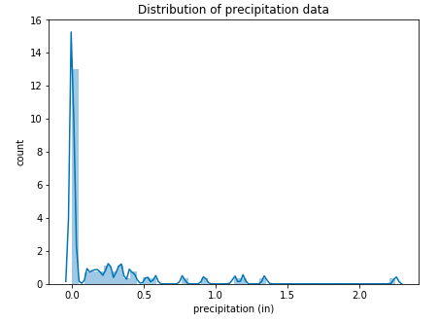
Precipitation data is sparse (see left). However, it is still relevant to note the heavy increase in inactive stations when no rain was recorded. This is logical, as biking becomes much more dangerous and less enjoyable when roads are wet.

Slide 20
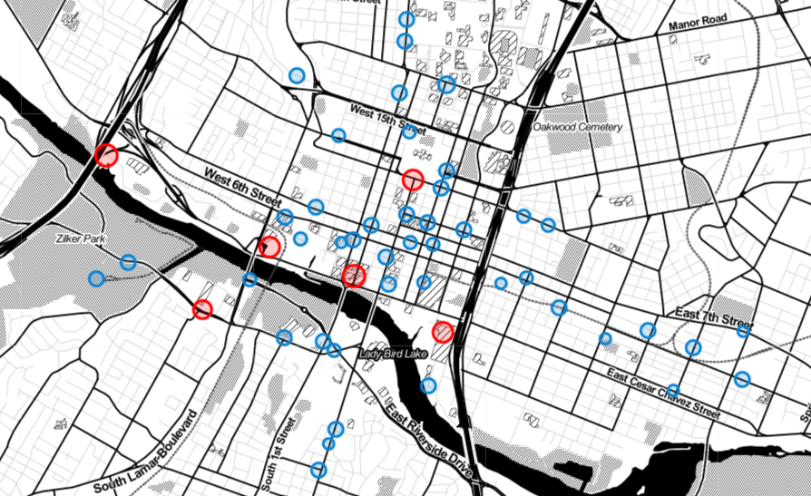
LOCATION + CAPACITY

Slide 21
I chose to segment stations based on a capacity threshold value of 14 docks
Red stations indicate those with capacities 15 and over
Blue show the remaining, smaller sized stations.
This map shows four large stations being located along Lady Bird Lake, a popular hike and bike trail.
One other large station is shown, Capital Station / Congress & 11th. This is probably to the high volume of tourists visiting the capitol building, since many other smaller stations exist downtown for work commuters.
Overall, we see a greater density of stations in regions where the capacity is low and vice versa.

Slide 22
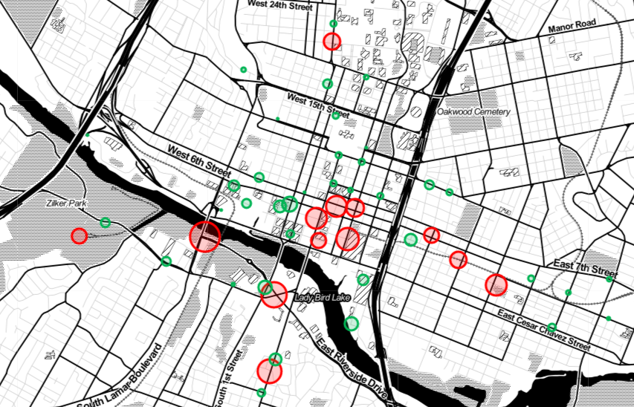
LOCATION + INACTIVITY LEVEL

Slide 23
Stations that were inactive more than 9.2% of the time are shown in red
Stations that were inactive less than 9.2% of the time are seen in green.
Additionally, the size of each circle corresponds to the degree to which the station is inactive.
I see three clusters of high inactivity levels in this figure: near the center of downtown, around zilker park, and east of highway 35. All three of these zones correspond to high traffic areas, albeit businesses, outdoor leisure, or bars.
There also exists a largely inactive station, Guadalupe & 21st, which is likely due to University of Texas students utilizing the bikes.

Slide 24
Predictive Modeling

Slide 25
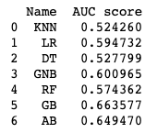
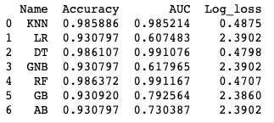
Baseline Tests:
Cross validation
Train test split
Both methods showed the Gradient Boosting classifier to perform the best, so this model was chosen for further hyperparameter tuning.

Slide 26
Baseline Gradient Boosting Model

Slide 27
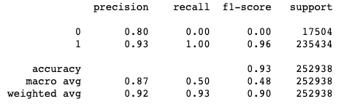
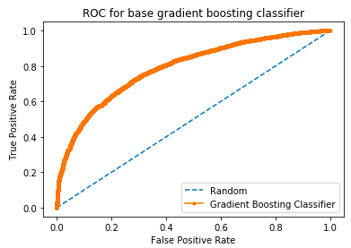

The base model has a good accuracy but the recall, f1-score and AUC suffer in this model.
Thus, hyperparameter tuning must be performed.
Confusion Matrix:

Slide 28
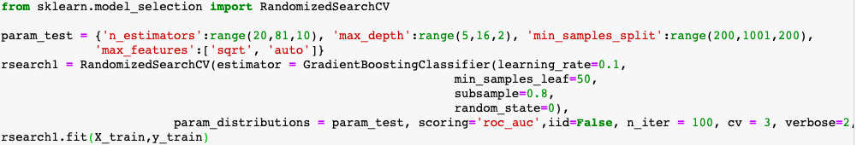
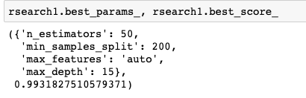
Randomized Search
A randomized search with 100 iterations was performed to find the optimal hyperparameters for our dataset.

Slide 29
Tuned Gradient Boosting Model
The previous parameters were validated in a tuned model using kfold cross validation

Slide 30
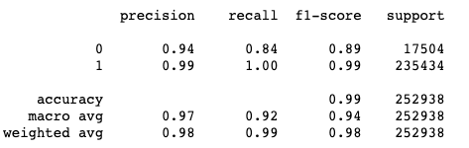

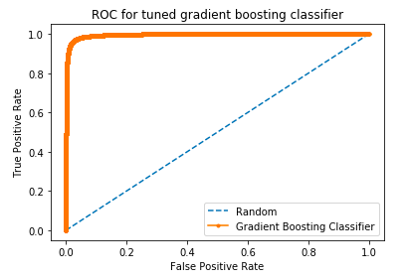
Improvements from base model:
Precision: 10%
Recall: 42%
F1-score: 46%
Accuracy: 9%
AUC: 20.2%
Confusion Matrix:

Slide 31
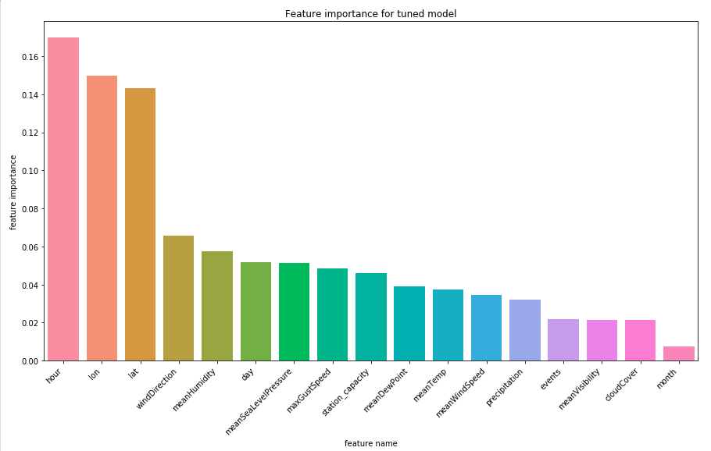
From this graph, we can see the three most important features are hour, longitude, and latitude.
Following these three, various weather features and the day of the week are seen, with month being the least significant predictor.

Slide 32
Hour being the top predictor is significant, as it indicates that the time of day is the most important factor as to whether or not a station becomes inactive.
In terms of actionable decisions, this could mean that Austin Bcycle replenishes stations during the most active times of day.
HOUR

Slide 33
LATITUDE
+
LONGITUDE
These two variables together represent location, which means that some areas of austin are more likely to rent a bike than others.
I would suggest that either the quantity of stations be increased in these hot areas, or that the capacity of stations within these areas is increased.

Slide 34
Month is probably ranked the lowest due to its low number of unique values.
If the data were expanded to include months other than April and May, this variable may increase in importance for the model. i.e. I would expect summer months to have more inactive stations than winter months.
MONTH

Slide 35
Conclusions
Results summary

Slide 36
I began by testing seven different classifiers in order to diversify my options, but found that the gradient boosting classifier performed best at baseline.

Slide 37
Baseline models all seemed to perform well in terms of accuracy, with the best having an accuracy of 93%. However, after looking into the classification report, I found the baseline models had poor recall and f-1 scores.

Slide 38
After extensive hyperparameter tuning, not only did the tuned model increase accuracy up to 99% (6% improvement), but the recall and f-1 statistics dramatically improved.

Slide 39
Additionally, the tuned gradient boosting classifier increased the area under the curve from 0.793 to 0.995, a 0.202 increase.

Slide 40
Evaluating the feature importances showed that the hour of day and location of the station are the most powerful predictors of inactivity.
I would suggest that Austin Bcycle refill stations at the most inactive time of day, as well as look into adding additional or larger stations in highly inactive locations.

Slide 41
Future Directions

Slide 42
Adding data from months other than April and May could introduce month as a more important predicting feature; The same could be said for year, since all of the data came from 2016.
Collecting data on average ride time would be valuable in understanding if stations become inactive more frequently when rider's embark on longer routes. It would also be interesting to know if some stations are correlated with a higher average ride time than others, leading to the need for a higher station capacity in a particular location.
Hyperparameter tuning should be done on other high performing baseline models, but was not done here due to time constraints.
Further exhaustive hyperparameter tuning by grid search should be done, but was not done here due to hardware limitations.

